Slide 1
Agenda
Start | End | Item
 |  | What is Text Mining (TM)?
 |  | Keyword Scanning
 |  | Preparation DTM/TDM
 |  | Associations & Dendrograms (Clustering)
 |  | Simple Wordcloud
 |  | Comparison Wordcloud
 |  | Polarity/Sentiment
Goals:
Learn the basics of text mining
Apply methods to real ( & messy) data

Slide 2
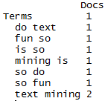
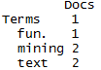
Tokenization
#bigram token maker
bigramTokens <-function(x)
unlist(lapply(NLP::ngrams(words(x), 2), paste, collapse = " "), use.names = FALSE)
wineTDM<-TermDocumentMatrix(txtCorpus, control=list(tokenize=bigramTokens))
Text Mining is so fun. So do Text Mining!
Unigram
Bigram
*with common stopwords
New Text Mining Concept
Tokenization- So far we have created single word n-grams. We can create multi word “tokens” like bigrams, or trigrams with this line function. It is applied when making the term document matrix.

Slide 3
What is a word cloud?
To make a word cloud we follow the previous steps and create a data frame with the word and the frequency.
# Get Row Sums
wineTDMv <- sort(rowSums(wineTDMm),decreasing=TRUE)
wineDF <- data.frame(word = names(wineTDMv),freq=wineTDMv)
Term Document Matrix
 | Tweet1 | Tweet2 | Tweet3 | Tweet4 | … | Tweet_n
Term1 | 0 | 0 | 0 | 0 | 0 | 0
Term2 | 1 | 1 | 0 | 0 | 0 | 0
Term3 | 1 | 0 | 0 | 2 | 0 | 0
… | 0 | 0 | 3 | 0 | 1 | 1
Term_n | 0 | 0 | 0 | 1 | 1 | 0
word | freq
Term1 | 0
Term2 | 2
Term3 | 3
… | 5
Term_n | 2
Setup
A word cloud is a visualization of term (token) frequencies.

Slide 4
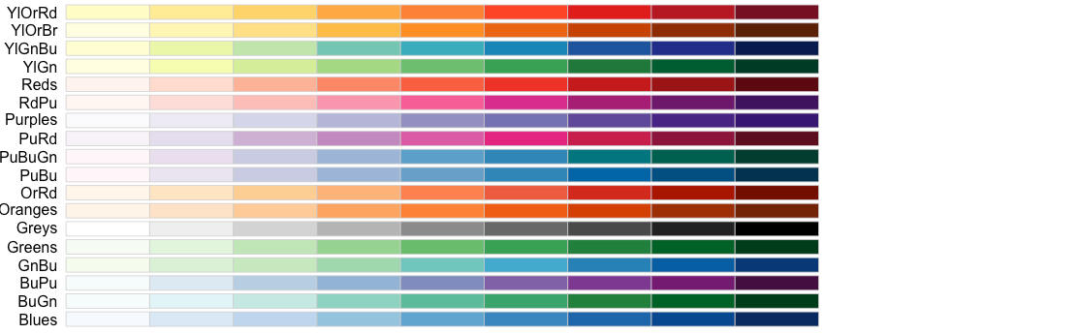
Selecting a color for your word cloud.
# Review all Pallettes
display.brewer.all()
# Choose a color & drop light ones
pal <- brewer.pal(8, "Blues")
pal <- pal[-(1:2)]

Slide 5
Let’s Practice!
D_Simple_Wordcloud_revised.R

Slide 6
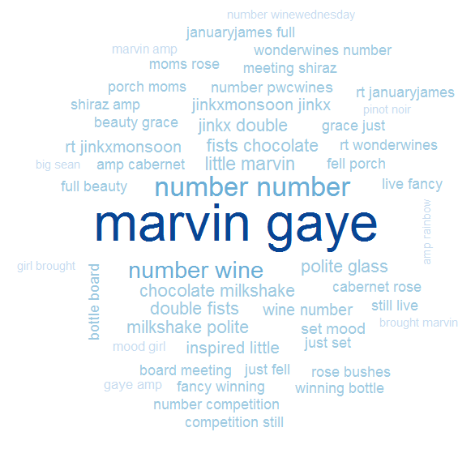
D_Simple_Wordcloud_revised.R
Bigram Tokenization has captured “marvin gaye”
A word cloud is a frequency visualization. The larger the term (or bigram here) the more frequent the term.
You may get warnings if certain tokens are too large to be plotted in the graphics device.
In cleanCopurs() the function … changes numeric with the generic string “number” so be careful with your preprocessing steps!

Slide 7
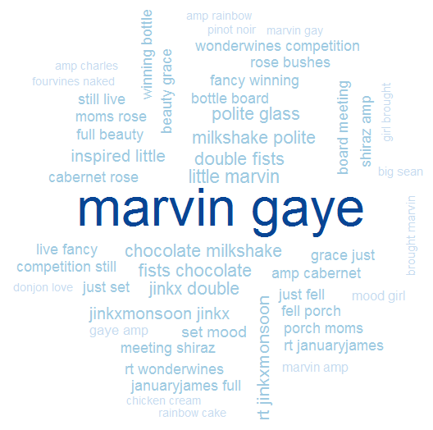
D_Simple_Wordcloud.R
In cleanCorpus() the function replace_symbol() changes numeric with the generic string “number” so be careful with your preprocessing steps!

Slide 8
Agenda
Start | End | Item
 |  | What is Text Mining (TM)?
 |  | Keyword Scanning
 |  | Preparation DTM/TDM
 |  | Associations & Dendrograms (Clustering)
 |  | Simple Wordcloud
 |  | Comparison Wordcloud
 |  | Polarity/Sentiment
Goals:
Learn the basics of text mining
Apply methods to real ( & messy) data

Slide 9
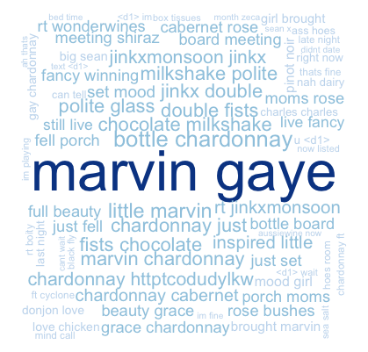
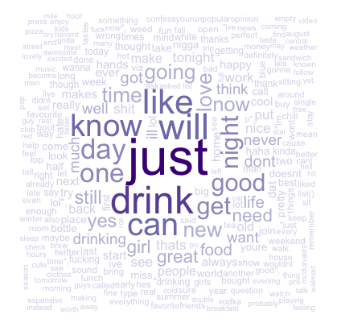
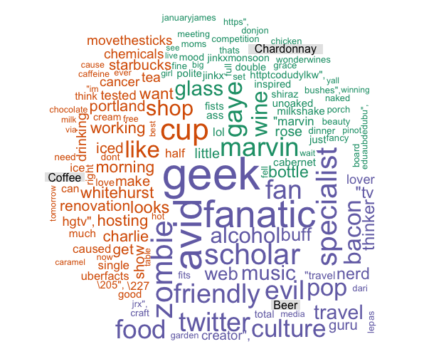
Types of Wordclouds
Multiple Corpora
Single Corpus
wordcloud( )
comparison.cloud( )
commonality.cloud( )
comparison.cloud( )
comparison.cloud( )

Slide 10
Dealing with many text files
The challenge is working with multiple corpora efficiently. Many ways to do it…
# Read in multiple files as individuals
txtFiles<-c('chardonnay.csv','coffee.csv','beer.csv') #use list.files() for a lot
for (i in 1:length(txtFiles)){
assign(txtFiles[i], read.csv(txtFiles[i]))
cat(paste('read completed:',txtFiles[i],'\n'))
}
# Read them into a single list with individual elements
allTxt<-pblapply(txtFiles,read.csv)
Two example ways to import csv files:
Each file is read in and an object created for each.
A list called “allTxt” is created. Each list element represents a single document. Using data.table::rbindlist() one can create a single document from all files in the folder.

Slide 11
Lets make some improved word clouds
Open E_Other_Wordclouds_revised.R

Slide 12
Agenda
Start | End | Item
 |  | What is Text Mining (TM)?
 |  | Keyword Scanning
 |  | Preparation DTM/TDM
 |  | Associations & Dendrograms (Clustering)
 |  | Simple Wordcloud
 |  | Comparison Wordcloud
 |  | Polarity/Sentiment
Goals:
Learn the basics of text mining
Apply methods to real ( & messy) data

Slide 13
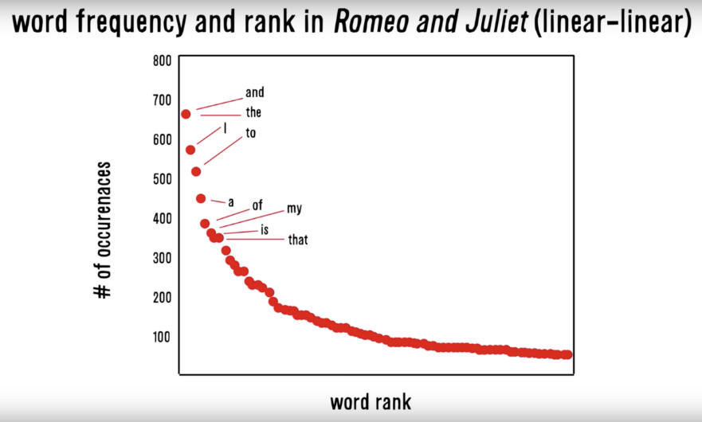
Zipf’s Law: Our words are less diverse than we think
Two very different contexts, channel, & messengers yet very similar pattern.
RT
I
Many words in natural language but also a steep decline in actual usage. Follows a predictable pattern.

Slide 14
Simple Sentiment Polarity
Scoring
Zipf’s Law
Surprise is a sentiment.
Hit by a bus! – Negative Polarity
Won the lottery!- Positive Polarity
Many words in natural language but there is steep decline in everyday usage. Follows a predictable pattern.
I loathe BestBuy Service -1
I love BestBuy Service. They are the best. +2
I like shopping at BestBuy but hate traffic. 0
R’s QDAP polarity function scans for positive words, and negative words as defined by MQPA Academic Lexicon research. It adds positive words and subtracts negative ones along with valence shifters. The final score represents the polarity of the social interaction.

Slide 15
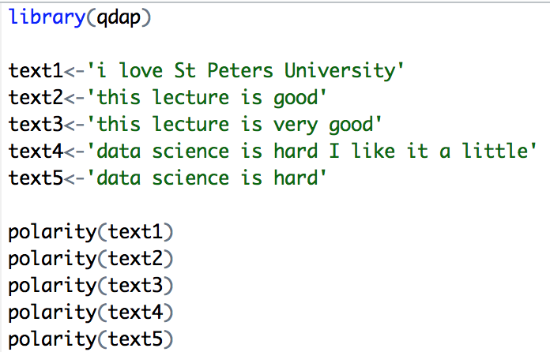
Simple Sentiment Polarity
Scoring
Text 1: “love” was identified as positive. The text has 5 words and so 1/sqrt(5) = .447
Text 2: “good” was identified positively. So 1/sqrt(4)=.5
Text 3: “good” was found along with the amplifier “very”. So (.8+1)/sqrt(5)=.805
Text 4: hard and like cancel each other out so the polarity is zero. 1-1/sqrt(9)=0
Text 5: “hard” is -1/sqrt(4)=-.50
First it looks for the polarized word. Then identifies valence shifters (default 4 words before and two words after) Amplifiers are assigned +.8 and de-amplifiers weight is constrained to -1. Lastly the sum is divided by the square root of the total number of words in the passage.

Slide 16
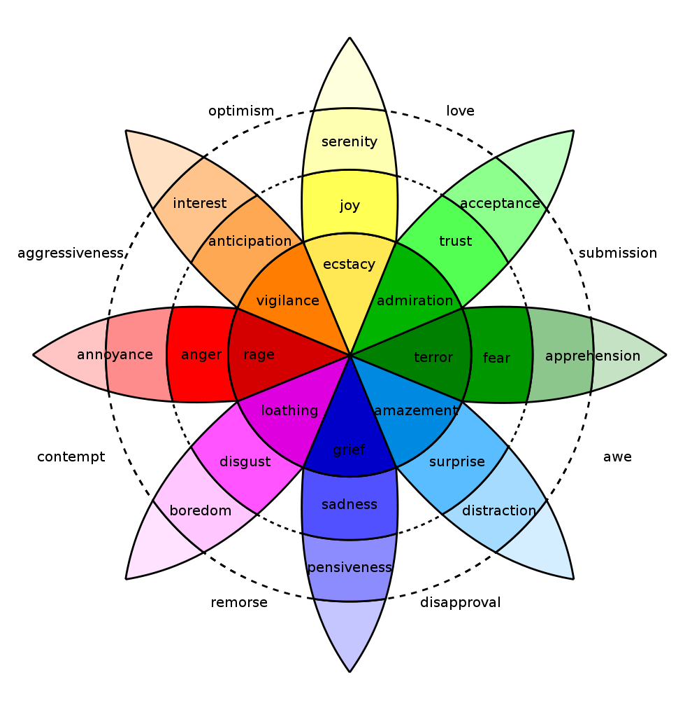
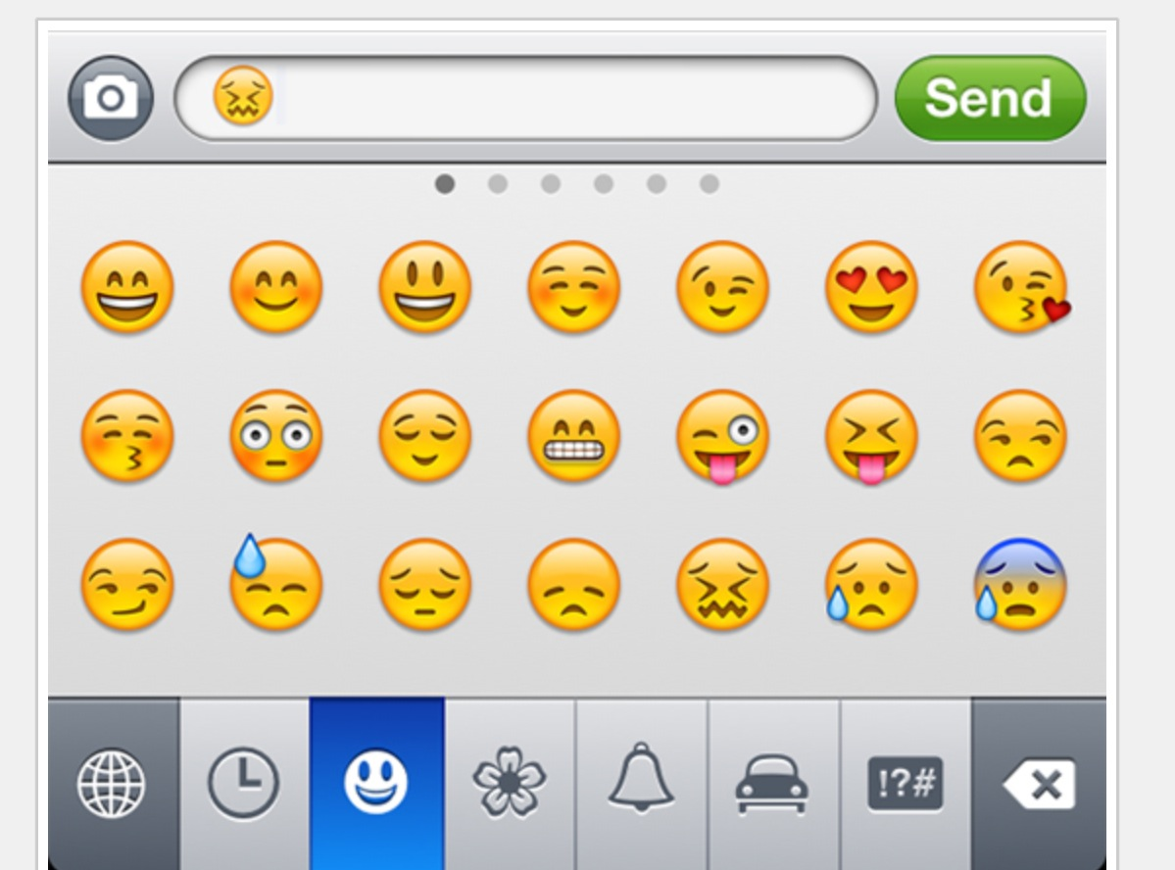
In reality sentiment is more complex.
Many Many Emoji
Plutchik’s Wheel

Slide 17
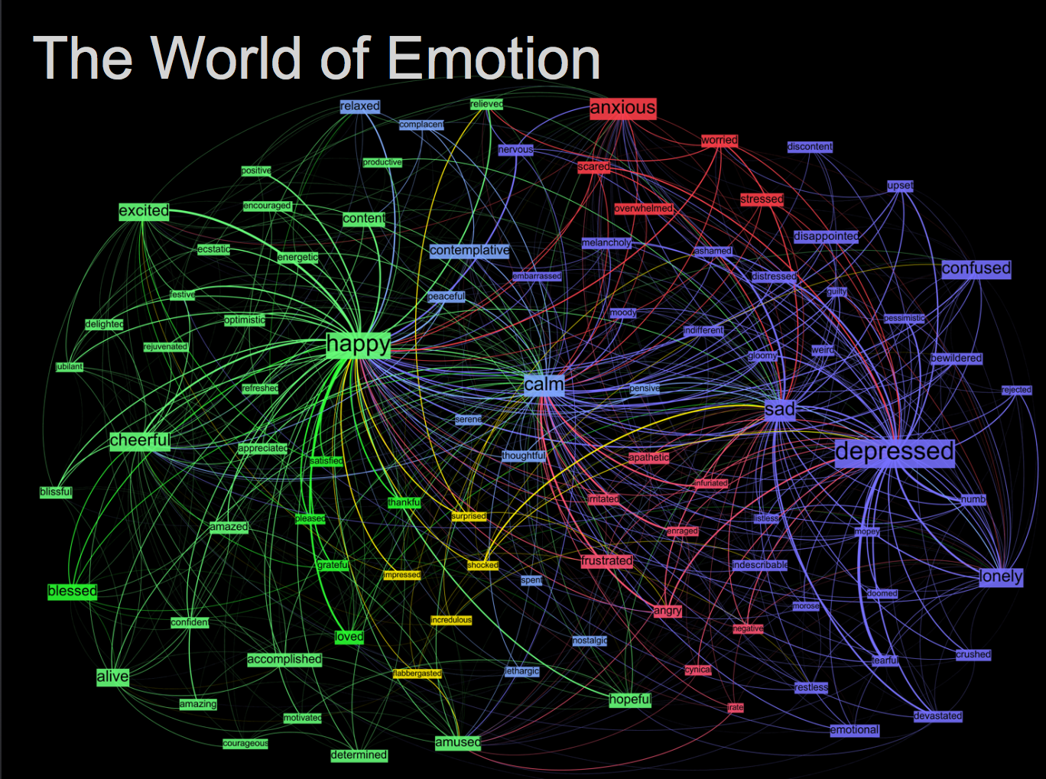
Kanjoya’s Experience Corpus

Slide 18
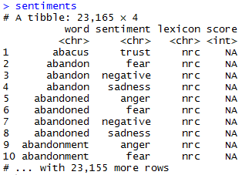
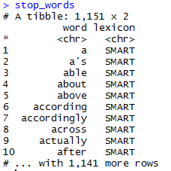
Sentiment the Tidy Way uses joins with existing lexicons
##Tidy Sentiment Analysis
data(sentiments)
sentiments
#Stopwords
data(stop_words)
stop_words
#Add stopwords
custom.stopwords<-data.frame(word=c('amp','beer'),
lexicon='custom')
stop_words<-rbind(stop_words,custom.stopwords)

Slide 19
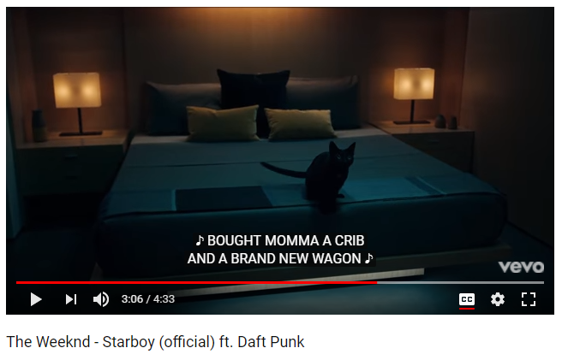
In this exercise we will examine song lyrics

Slide 20
Tidy data uses %>% to forward objects
Tidytext is part of the tidy universe including ggplot and dplyr. Code is structured so it is more easily read using the %>%. The data format is a tibble and is in “tidy” format (long form).
mtcars %>% group_by(cyl) %>% mutate(rank = min_rank(desc(mpg)))
This reads as “Using the mtcars object then group by the cyl vector then mutate a new variable called rank.

Slide 21
Tidy can seem complicated but not impossible.
The pipe operator
%>%
Forwards an object so the code is easy to understand & concise.
all.tidy <- all.tidy %>%
anti_join(stop_words)
Song text
Stop words
anti_join()
all.sentiment <- all.tidy %>%
inner_join(nrc.lexicon) %>%
count(tweet,sentiment) %>%
spread(tweet, n, fill = 0)
Sentiment
words
Song text
inner_join()

Slide 22
Starting with a DTM, its straightforward
# DTM
txtDTM<-DocumentTermMatrix(txtCorpus)
txtDTM
dim(txtDTM)
# Tidy
tidyCorp<-tidy(txtDTM)
tidyCorp
dim(tidyCorp)
# Get bing lexicon
# "afinn", "bing", "nrc", "loughran"
bing<-get_sentiments(lexicon = c("bing"))
head(bing)
# Perform Inner Join
bingSent<-inner_join(tidyCorp,bing, by=c('term'='word'))
DTM is from the “tm” library
Easy way to make it into a tibble.
Weeknd Lyrics
Bing Lexicon

Slide 23
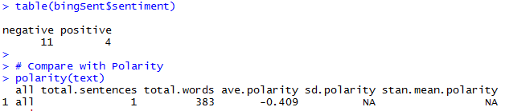
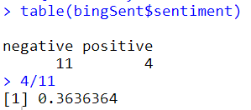
Similar polarity scores in both methods
Weeknd Lyrics
Bing Lexicon
The polarity function from qdap and the inner_join show similar negative results.

Slide 24
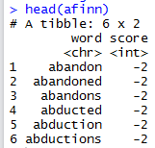
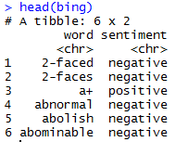
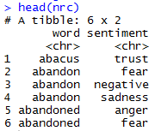
TidyText has other sentiment lexicons
Each can be used in an inner join to get different ways of assessing sentiment.
AFINN- Dutch researcher
Words scored -5 to 5
Bing- U of I-Chi Researcher
Words scored Pos/Neg
NRC – mTurk
Words classified into 8 primary & pos/neg
Weeknd Lyrics
Sentiment Lexicon

Slide 25
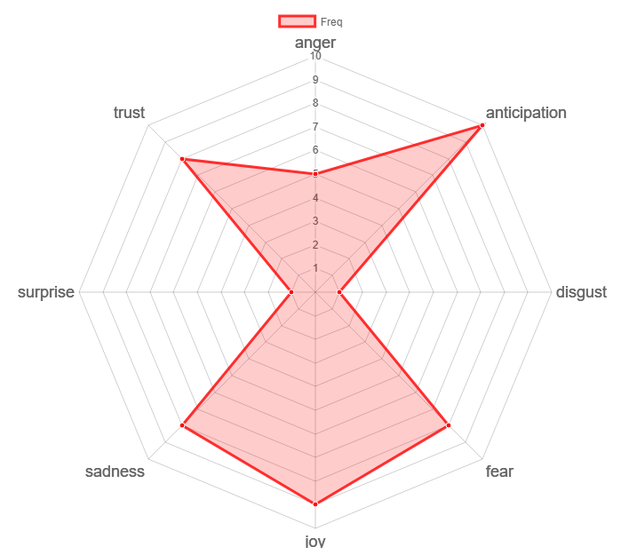
Remember Plutchik’s Wheel of emotion? Let’s mimic it!
The script drops positive & negative to focus on the explicit emotions.

Slide 26
Let’s practice sentiment analysis
Open 6_TidyText_Sentiment_revised.R
Open F_TidyText_Sentiment_revised.R

